Slide 1
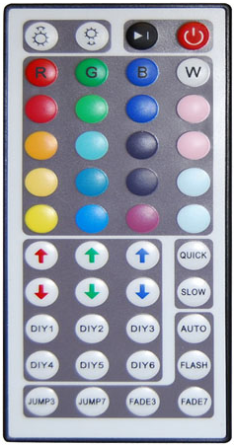
Ambilight / Moodlight
>2s Standby
Moodlight: Brightness
Ambilight: Inc/Dec parameter
Ambilight: Video channel
JumpMode --- | Period |Amplitude | Base
Hue | Saturation | Contrast | Brightness

